Slide 1
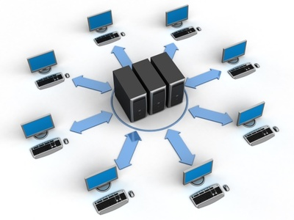
Network Fundamentals
Network Models: updated tcp/ip model

Slide 2
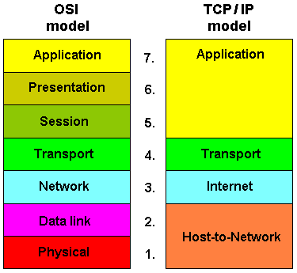
Objectives:
The backstory behind the DoD TCP/IP model.
Detailed refresh over common services and protocols.
Challenging test.

Slide 3
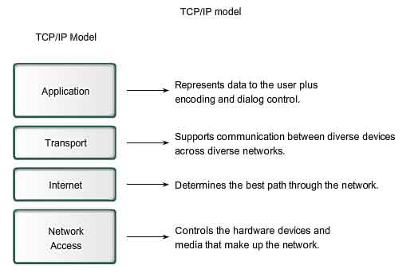
The backstory behind the DoD TCP/IP model:
It’s been created by the U.S department of defense.
It’s designed to describe the complete view of data connecting between any two connecting devices into the Arpanet.

Slide 4
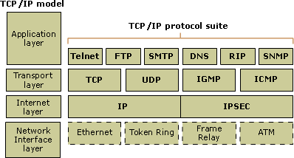
Detailed refresh over common services and protocols :

Slide 5
Objectives:
The backstory behind the DoD TCP/IP model.
Detailed refresh over common services and protocols.
Challenging test.

Slide 6
CCNA Routing & Switching
Network Models: updated tcp/ip model

